Slide 1
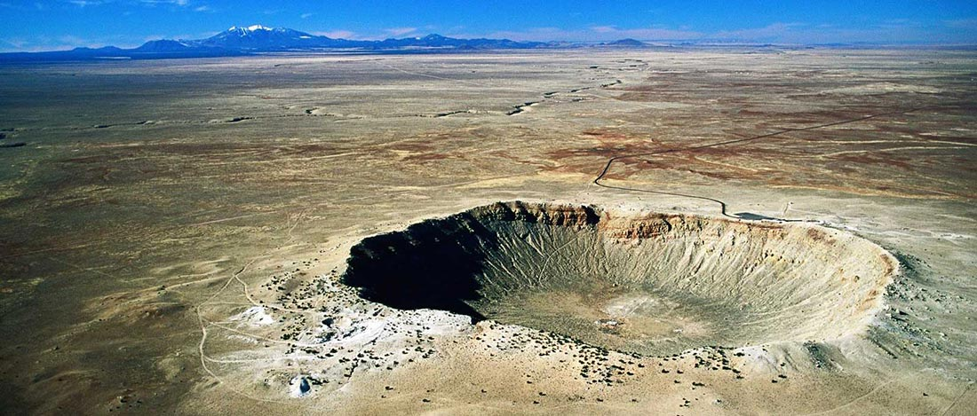
Meteor Crater, Arizona
Meteor Crater is the breath-taking result of a collision between an asteroid traveling 26,000 miles per hour and planet Earth approximately 50,000 years ago, and is nearly one mile across, 2.4 miles in circumference and more than 550 feet deep.

Slide 2
Live Science
Crash! 10 Biggest Impact Craters on Earth
By Becky Oskin, Senior Writer | April 28, 2014 07:48am ET
https://www.livescience.com/45126-biggest-impact-crater-earth-countdown.html

Slide 3
Ancient scars
Whether they're the size of a molehill or a mountain, meteorite impacts are one of the most destructive forces in the solar system.
Here on Earth, flying space debris triggered mass extinctions, but the same deadly asteroids might also have delivered the seeds of life soon after Earth was born.
The effects of asteroid impacts linger for billions of years. Here are the 10 biggest impact craters known, from largest to smallest.

Slide 4
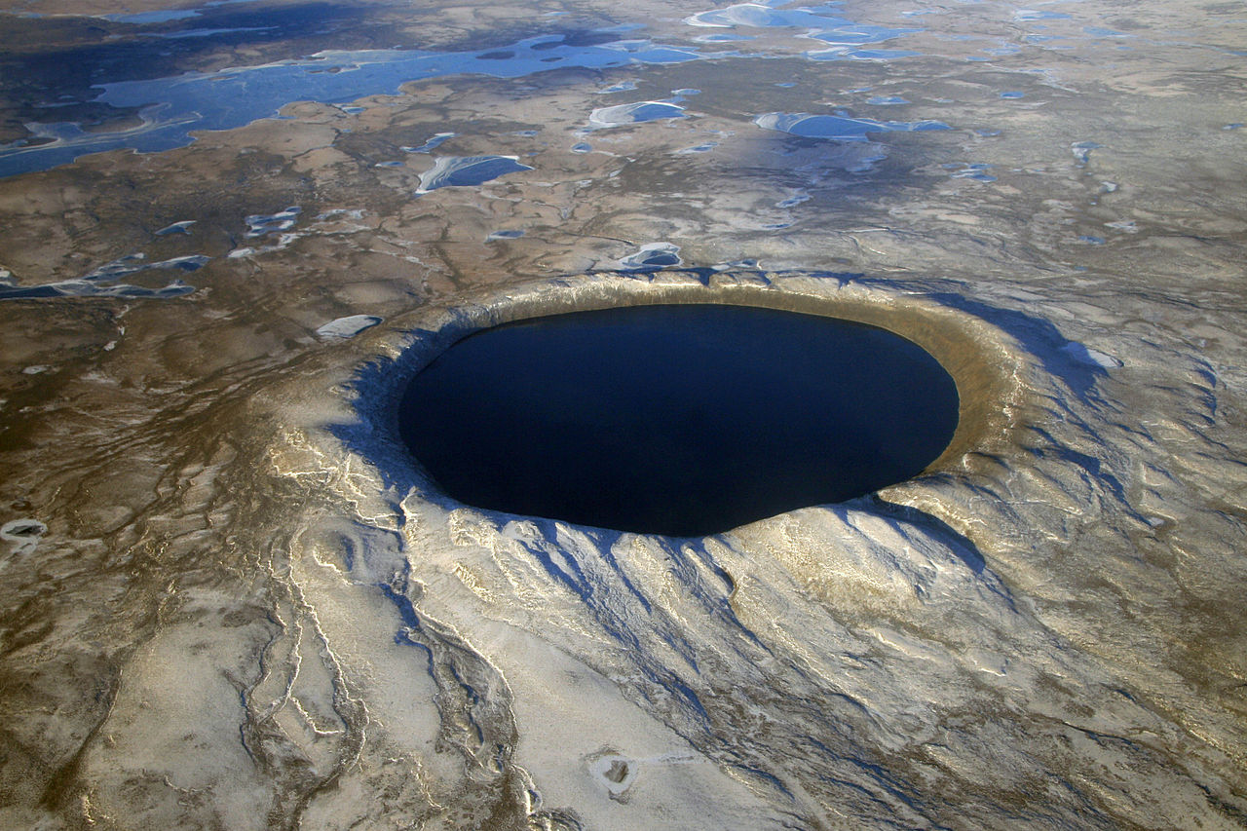
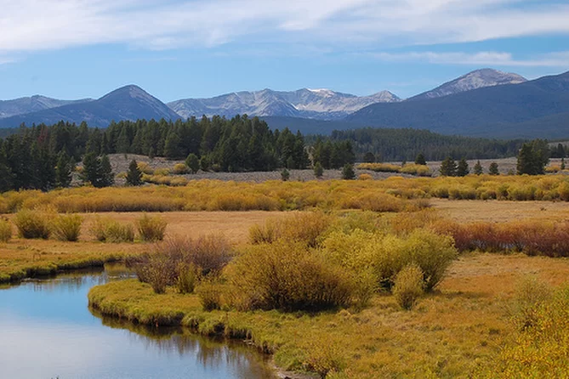
10. Beaverhead crater
This 600-million-year-old crater spans Montana and Idaho and is the second-largest impact crater in the United States.
Little remains at the surface of the 37-mile-wide (60 km) crater, which wasn't discovered until the 1990s.
That's when shatter cones — cone-shaped, violently-shocked rock — were found in Beaverhead in southwestern Montana.
The crater is centered in Challis, Idaho.

Slide 5
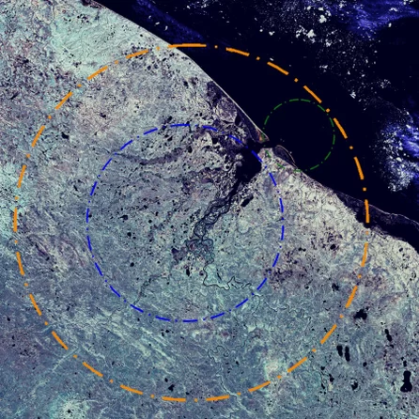
9. Kara crater
Kara crater is a 70.3-million-year-old eroded crater exposed in Russia's Yugorsky Peninsula.
Researchers think the 40-mile-wide (65 km) crater was once more than 75 miles (120 km) in diameter.

Slide 6
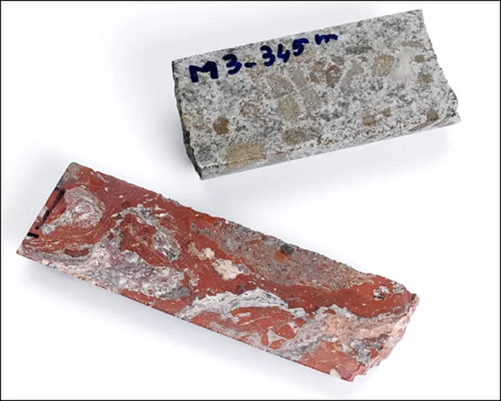
*8. Morokweng crater
Morokweng Crater is buried beneath South Africa's Kalahari Desert: Geologists discovered it through remote sensing surveys.
But scientists got a surprise when they drilled into the crater looking for rock samples to confirm the impact.
The remains of the meteorite that created this crater were still in its depth. The drill brought back a 10-inch (25 centimeter) fragment of the original meteorite from about 842 yards (770 meters) below the surface.
Morokweng formed 145 million years ago and is 44 miles (70 km) wide.

Slide 7
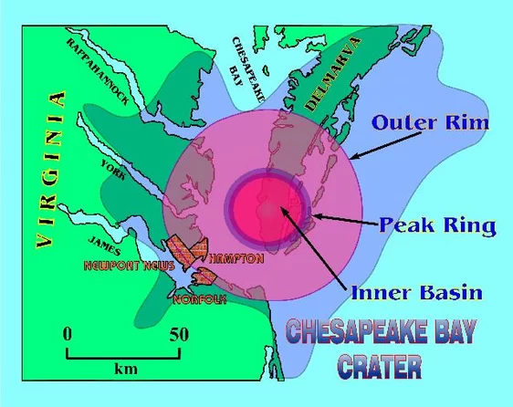
*7. Chesapeake Bay crater
Buried under seafloor muds, Chesapeake Bay Crater offshore of Virginia is an estimated 35 million years old.
The curving western shoreline of Chesapeake Bay takes its shape from the 53-mile-wide (85 km) marine crater.
A drilling core revealed the first hints that a large impact crater was buried beneath the bay in 1983, when the core brought up an 8-inch-thick (20 centimeters) layer of impact ejecta.

Slide 8
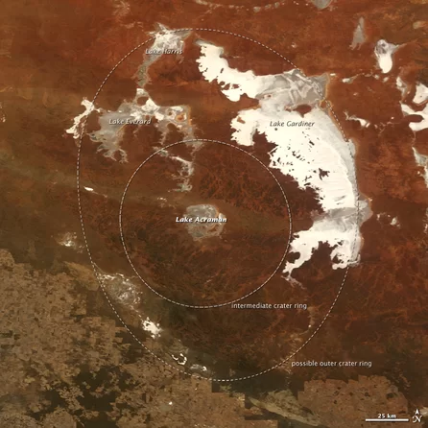
*6. Acraman crater
Lake Acraman fills this round impact crater, excavated 580 million years ago in South Australia.
The crater measures 56 miles (90 kilometers) in diameter.
Impact ejecta from the crater can be found in the Flinders Range 185 miles (300 km) to the east, among rocks with fossils of the first complex life forms on Earth.

Slide 9
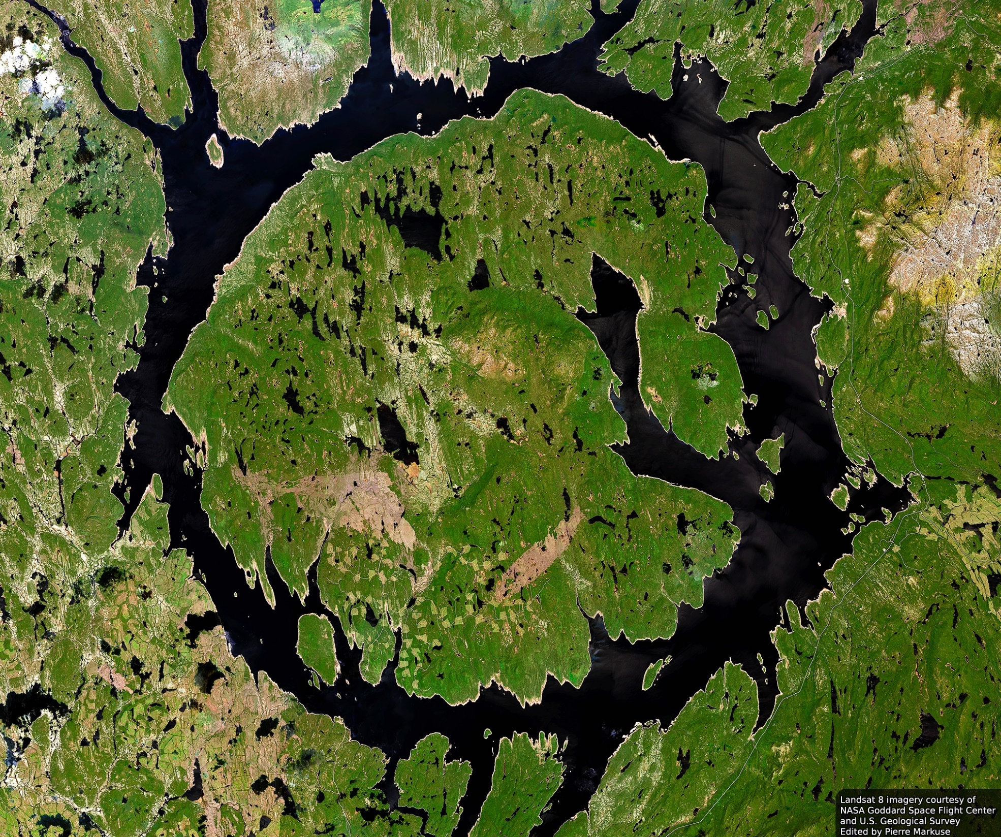
5. Manicouagan crater
Our first lake-filled crater, Manicouagan in Quebec is one the largest and best-preserved crater on the planet.
The 62-mile-wide (100 km) crater is 214 million years old.

Slide 10
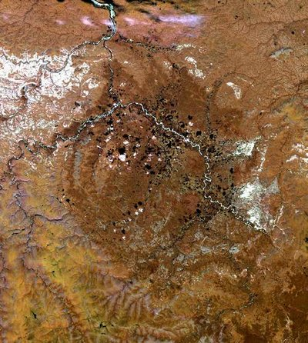
4. Popigai crater
A rare find is buried in Russia's Popigai crater: diamonds. Some 35 million years ago, a meteorite crashed into carbon-rich graphite rock deposits in Siberia, and the impact's immense pressures and temperatures converted the carbon into diamonds.
The crater is 62 miles (100 km) wide and holds massive diamond reserves, according to the Russian government.

Slide 11
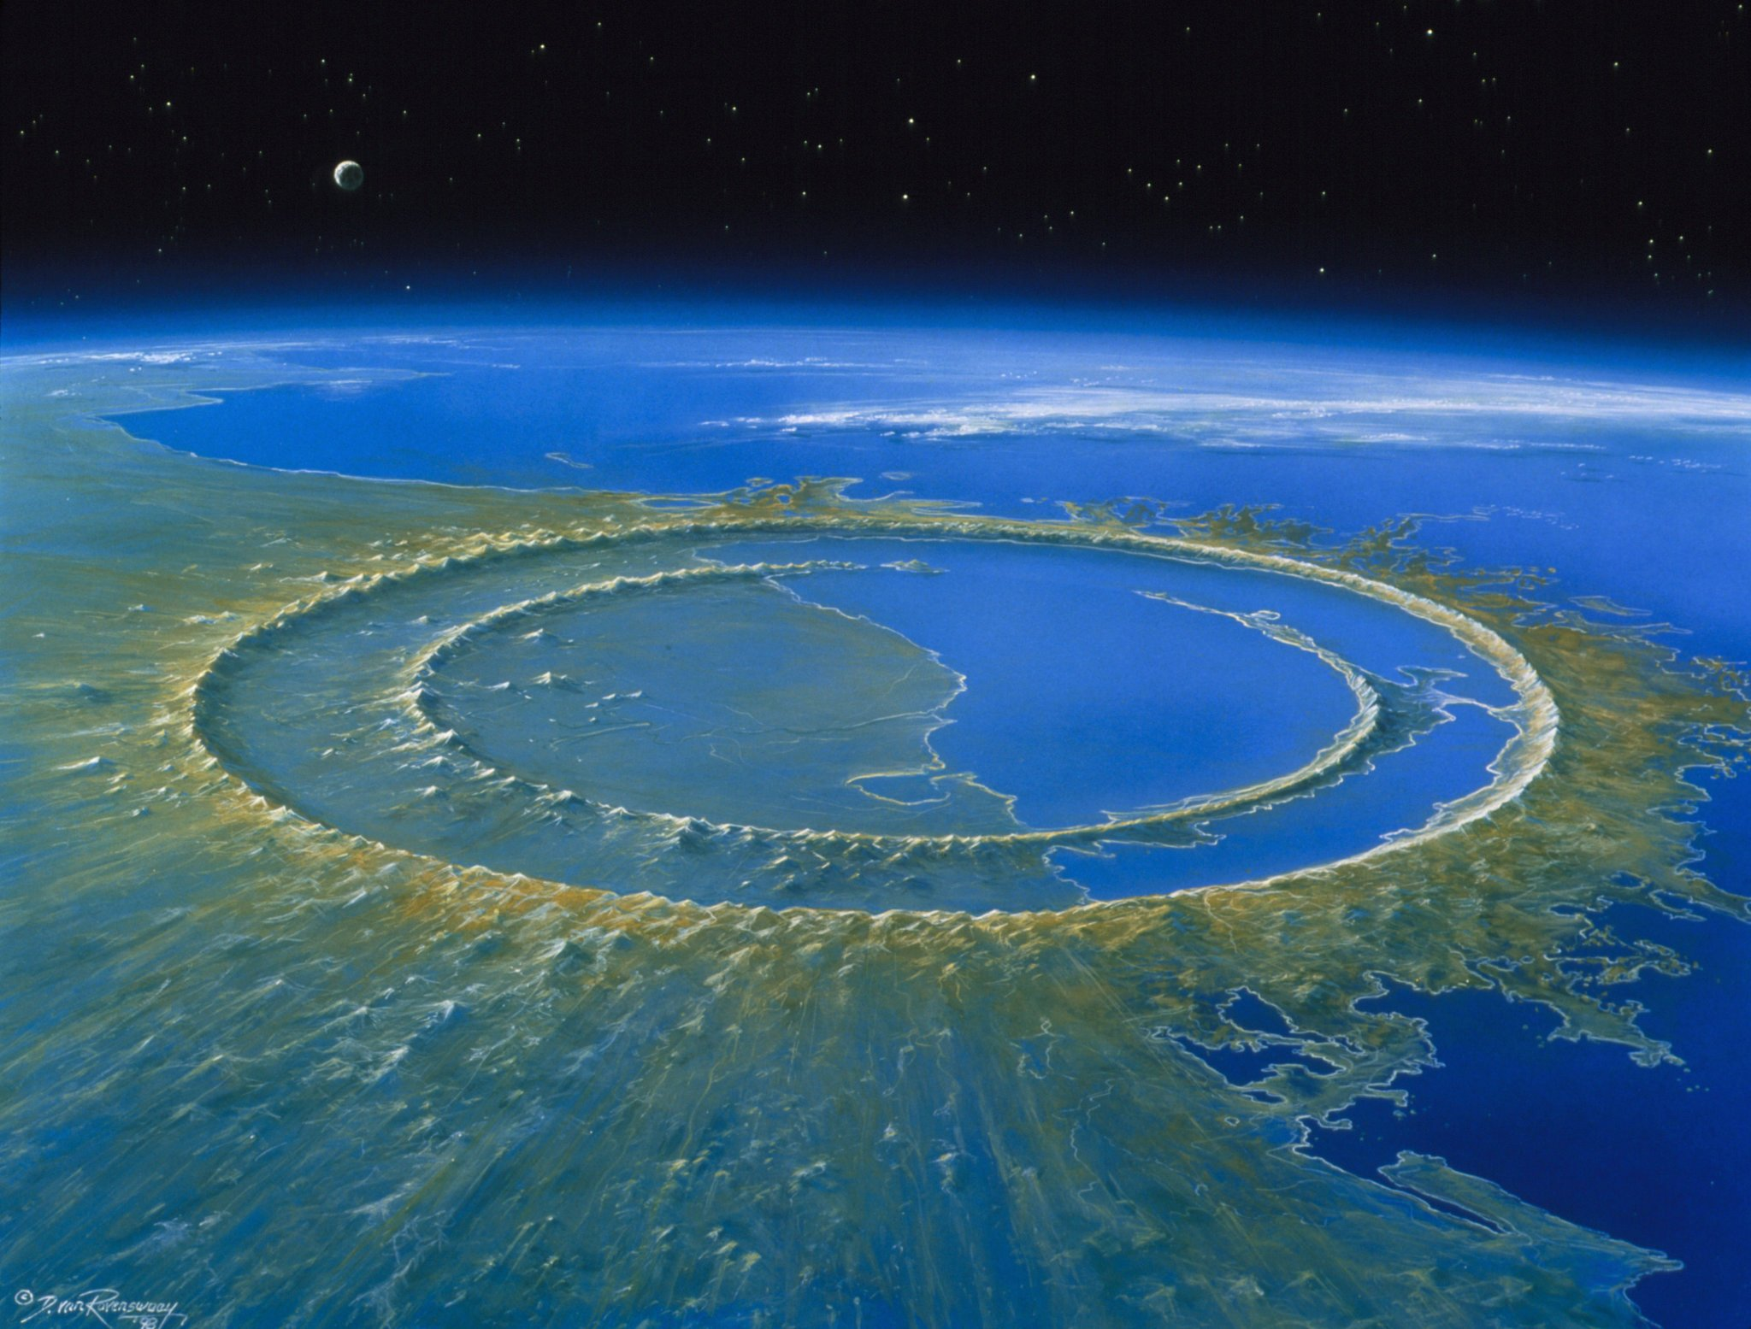
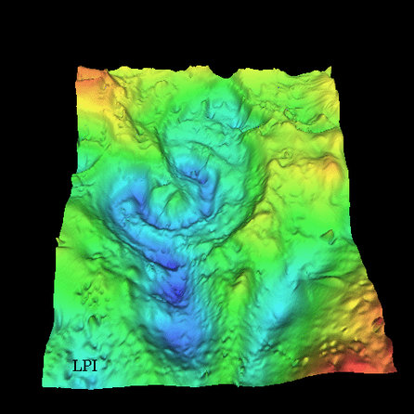
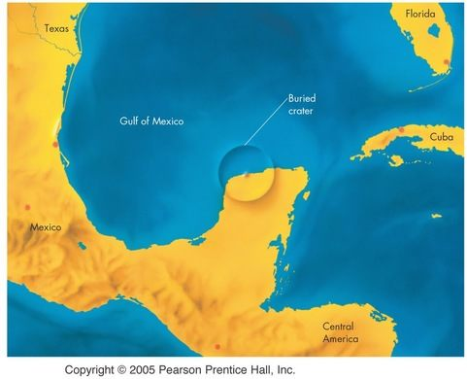
3. Chicxulub crater
Chicxulub crater's discovery clinched what was once a wild theory: that a meteor impact wiped out the dinosaurs.
A thin layer of exotic iridium metal from a meteor impact had been detected worldwide at Cretaceous mass extinction before Chicxulub was found. Now, the meteorite that carved the Chicxulub crater in Mexico's Yucatan Peninsula is widely thought to have caused or greatly contributed to the mass extinction at the end of the Cretaceous 65 million years ago, including the end of the dinosaurs.
Some scientists think Chicxulub's original crater may have been bigger than Sudbury crater in Ontario. Estimates of its original diameter range up to 150 miles (240 km) in diameter, and its current size is 93 miles (150 km).

Slide 12
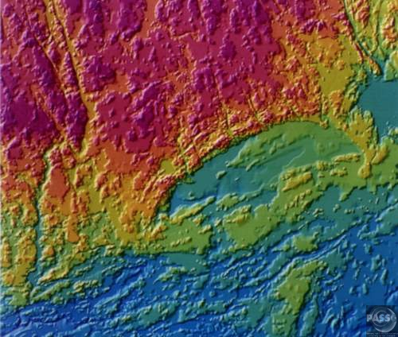
*2. Sudbury crater
Sudbury crater in Ontario, Canada, clocks in at 81 miles (130 km) wide and 1.85 billion years old, close in age and size to Vredefort crater in South Africa.
The original crater is believed to have sprawled 160 miles (260 km). Rock fragments from the impact have been found in Minnesota, over 500 miles (800 km) away.

Slide 13
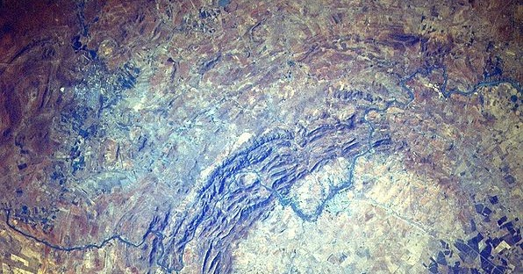
*1. Vredefort crater
Vredefort crater is the largest meteorite impact site on Earth at 300 km (186 MILES) across. It is located in South Africa and formed about 2bya. It contains quartzites, banded ironstones, and dolomite.
http://dinopedia.wikia.com/wiki/Vredefort_crater

Slide 14
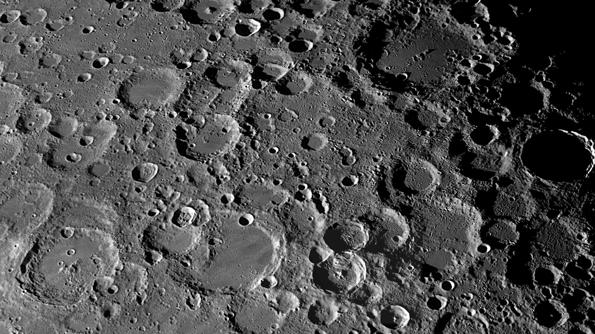
Craters on the moon

Slide 15
Question (Exit Card):
What makes the difference of diameter and depth of a crater?
In other words: What is it about the meteor that makes the impact so big?
What conditions make the ejecta move out far and wide?

Slide 16
Chelyabinsk Meteor Impact
Video:
Russia Meteor:
https://www.youtube.com/watch?v=dpmXyJrs7iU
PBS Meteors: Crash Course Astronomy
https://www.youtube.com/watch?v=TuDfZ2Md5x8
Article:
https://en.wikipedia.org/wiki/Chelyabinsk_meteor
GIF: https://en.wikipedia.org/wiki/Chelyabinsk_meteor#/media/File:Meteoroid_-_Meteor_(Bolide)_-_Meteorite.gif

Slide 17
Key Phenomena Observations
Large amounts of light
Streaks of clouds
Shock wave – very loud boom sometime later – after the meteor passes by.
Lots of damaged glass, car alarms going off, things shaking with additional sound cracking's after words.
Damage to a manufacturing plant / brick building.

Slide 18
Other key phenomena witnessed (Article)
People felt the heat from the meteor.
People said that it smelled like “gun powder”, “sulfur” & “burning odors” after about an hour after it passed.

Slide 19
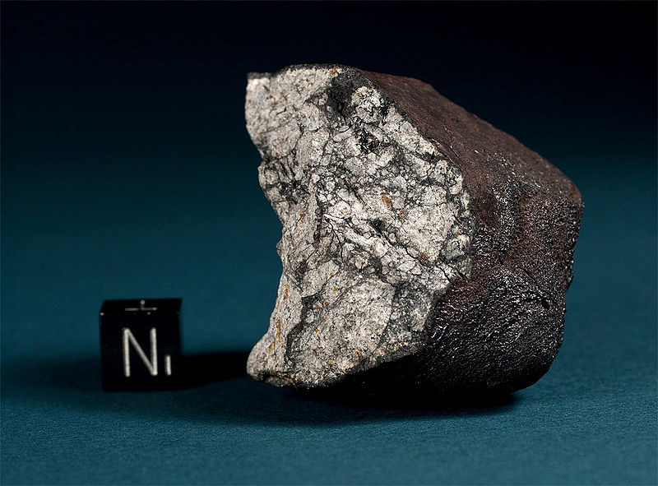
Cheljabinsk meteorite fragment
English: 112.2 g fragment of the Chelyabinsk (Cherbakul) meteorite. This specimen was found on a field between the villages of Deputatsky and Emanzhelinsk on February 18, 2013. The broken fragment displays thick primary fusion crust with flow lines and a heavily shocked matrix with melt veins and planar fractures. Scale cube is 1 cm.

Slide 20
Questions that I have
Why was it so bright?
How did it form clouds?
Why was the sound so loud?
How big was the meteor and how fast was it going?
Did it reach the ground? If so, what damage did it cause?
If it did reach the ground – why was it no where near damaging compared to the craters found around the world?
Why would the meteor break up?

Slide 21
Questions that I have
Why was it so bright?
How did it form clouds?
Why was the sound so loud?
How big was the meteor and how fast was it going?
Did it reach the ground? If so, what damage did it cause?
If it did reach the ground – why was it no where near damaging compared to the craters found around the world?
Why would the meteor break up?
Mythbusters – shooting a gun into water.

Slide 22
Task 1: Draw a model
Draw a model that points out all of the phenomena from the meteor’s entry into the atmosphere and each stage of the meteor’s travel through the atmosphere to the end of its travels.
Point out each part of the phenomena witnessed. The height, light, sound, smoke, damages on the ground etc.

Slide 23
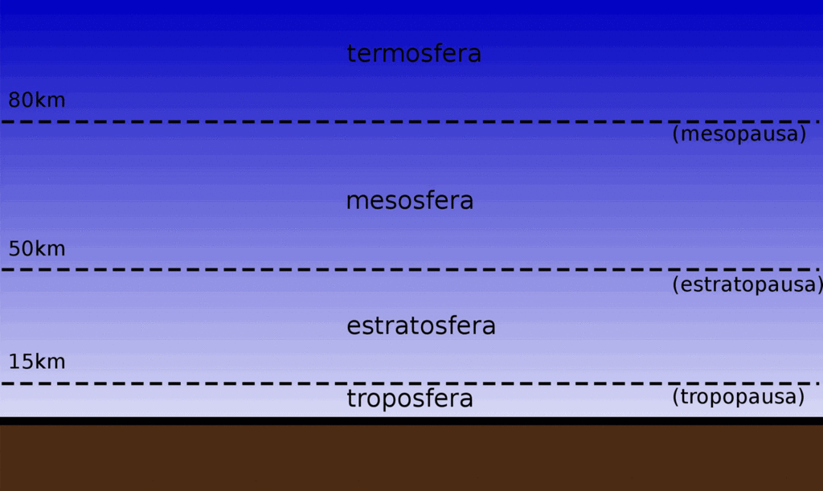

Slide 24
Resources
https://www.lpi.usra.edu/exploration/education/hsResearch/crateringLab/lab/part1/background/
Oskin, B (April 28, 2014) Crash! 10 Biggest Impact Craters on Earth, Livescience.com, https://www.livescience.com/45126-biggest-impact-crater-earth-countdown.html
USRA (2017) Impact Cratering Lab Part I: Impact Cratering Mechanics & Crater Morphology, Lunar and Planetary Institute, https://www.lpi.usra.edu/exploration/education/hsResearch/crateringLab/lab/part1/background/

Slide 25
Phenomena Group 1: Different sized craters
No. | Crater | Crater Diameter | Additional Notes
1 | Arizona | 1 Mile | 550 ft deep
2 | 8. Morokweng crater | 44 Mile | Meteor was 2,500 ft deep
3 | 6. Acraman | 56 Miles | 185 Mi. Ejecta
4. | 4. Popagai | 62 Miles | Made Diamonds
5. | 3. Chicxalub | 150 Mile | Killed the dinosaurs
6. | Sudbury | 160 Mile | 500 Mile ejecta

